Slide 1
CS162 Operating Systems and Systems Programming Lecture 25 Extra Topics: IoT, Quantum Computing
May 4th, 2015
Prof. John Kubiatowicz
http://cs162.eecs.Berkeley.edu

Slide 2
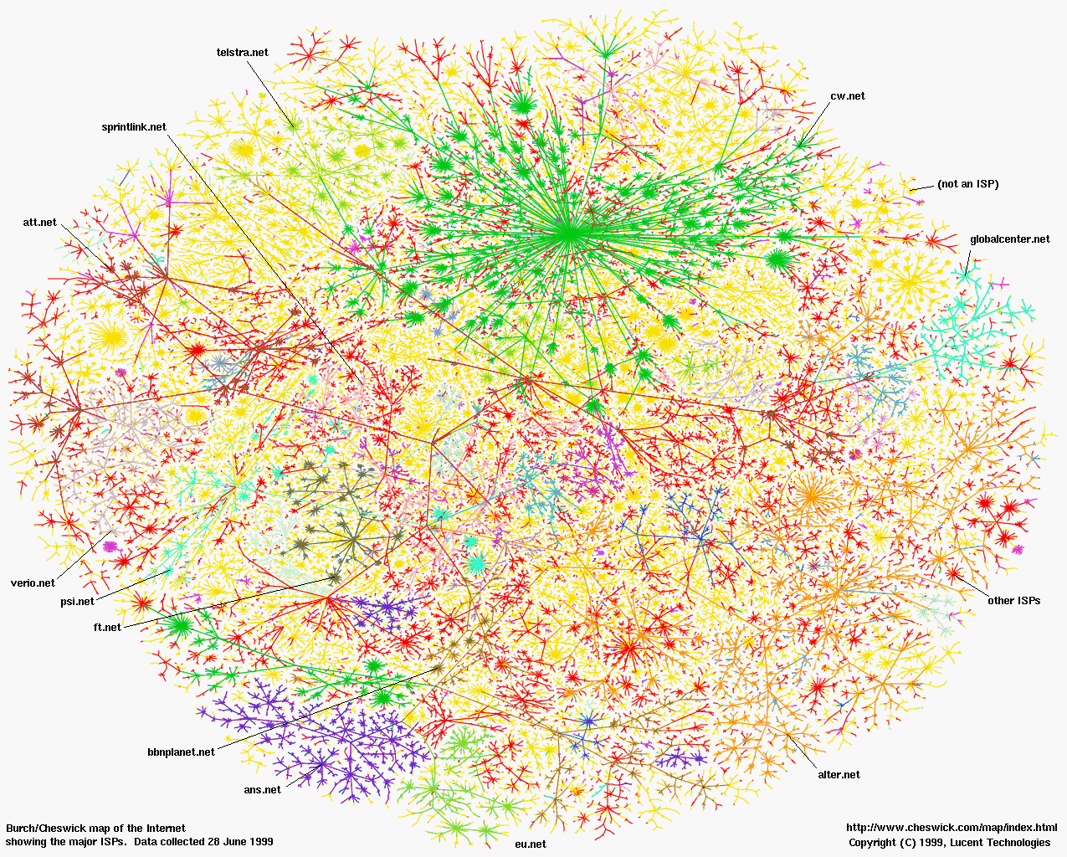

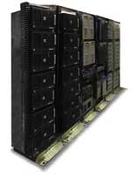
1997 - The Internet of Every Computer

Slide 3

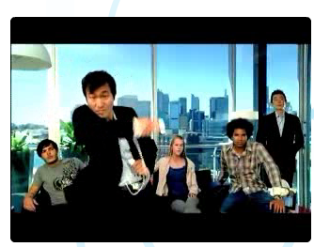

2007 - The Internet of Every Body

Slide 4
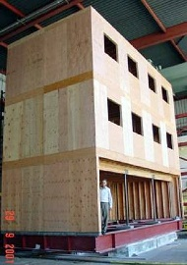
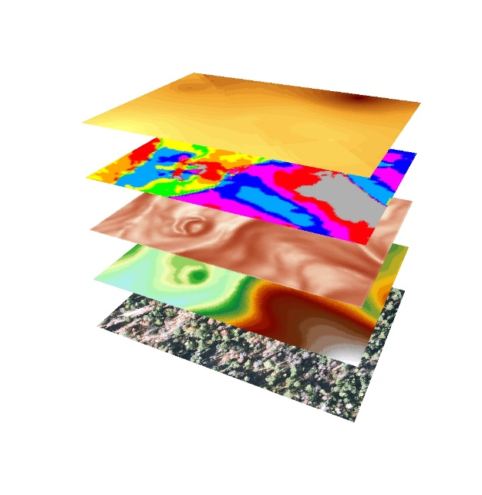
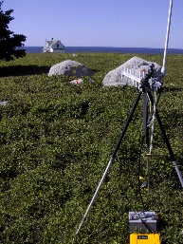
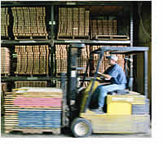
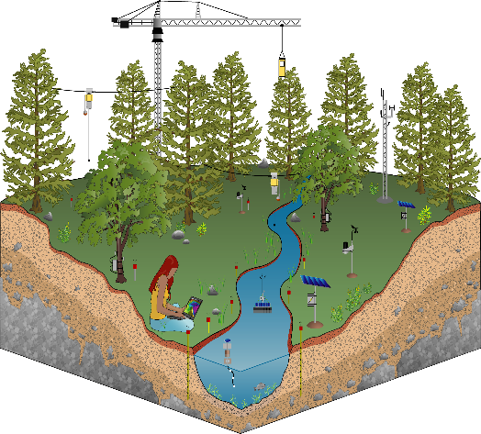
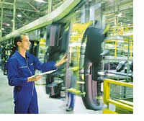

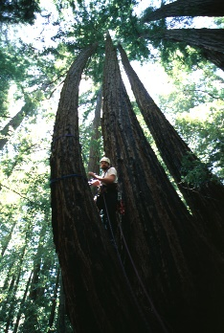
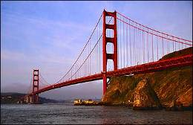
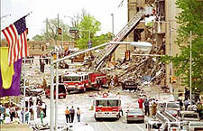
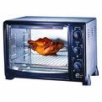
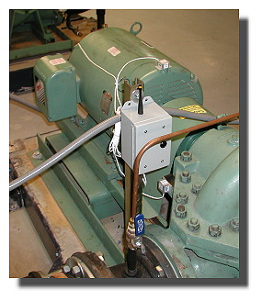
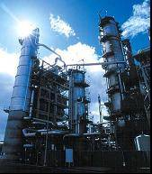
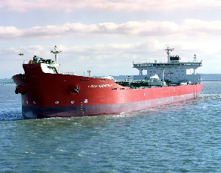

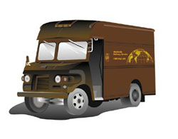
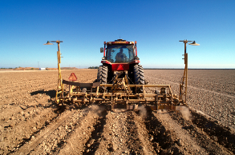


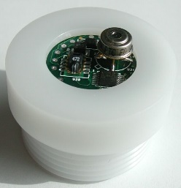
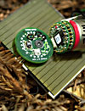
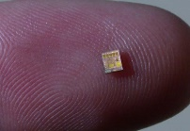
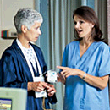
2017 - The Internet of Everyday Things

Slide 5
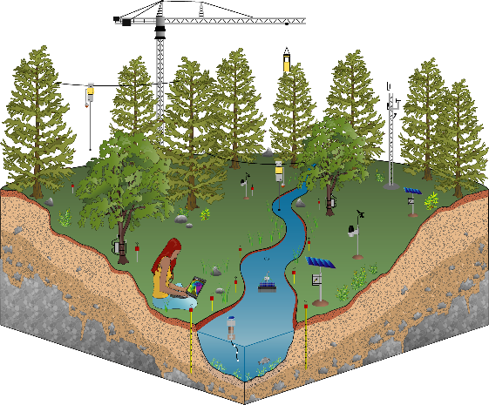
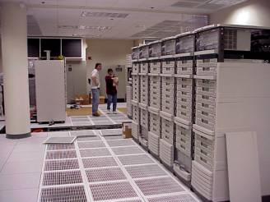
Why “Real” Information is so Important
Save Resources
Improve Productivity
Enable New Knowledge
Increase
Comfort
Enhance Safety & Security
Preventing Failures
High-Confidence Transport
Improve Food & H20
Protect Health

Slide 6
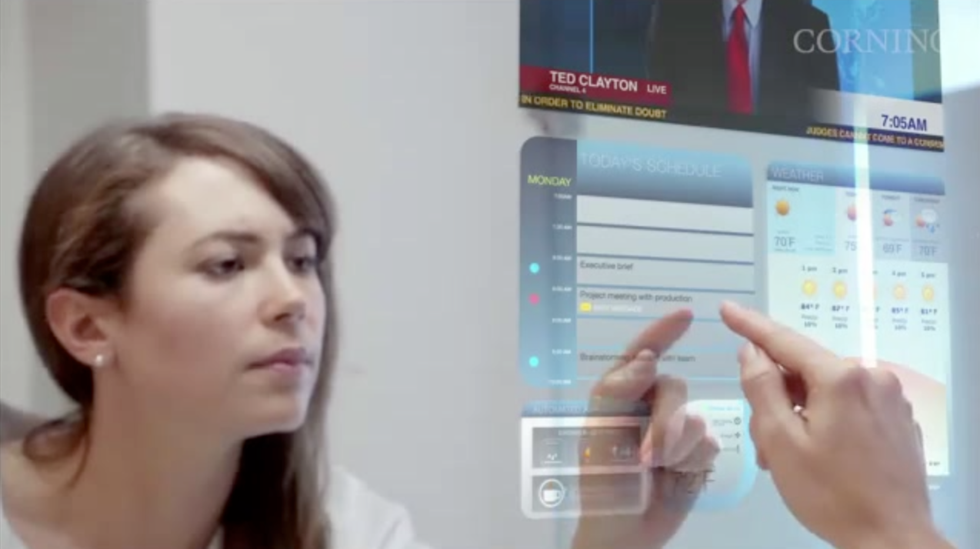
Resources in a Smart Space (2011)
Potential Displays Everywhere
Walls, Tables, Appliances, Smart Phones, Google Glasses….
Audio Output Everywhere
Inputs Everywhere
Touch Surfaces
Cameras/ Gesture Tracking
Voice
Context Tracking
Who is Where
What do they want
Which Inputs map to which applications

Slide 7
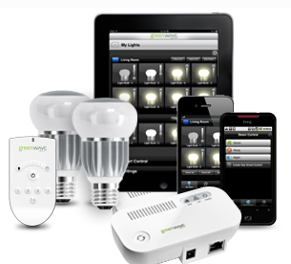
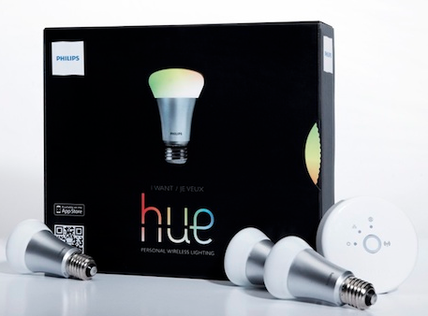
2013

Slide 8
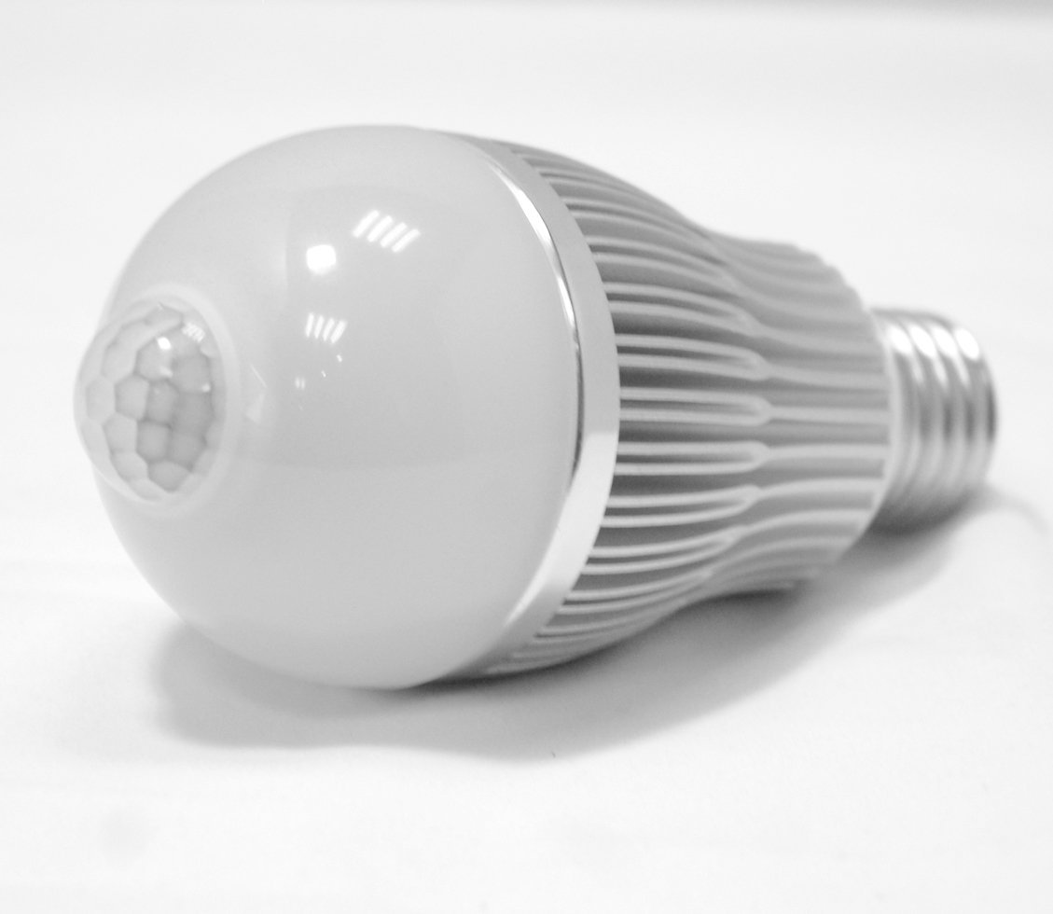
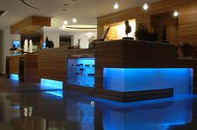
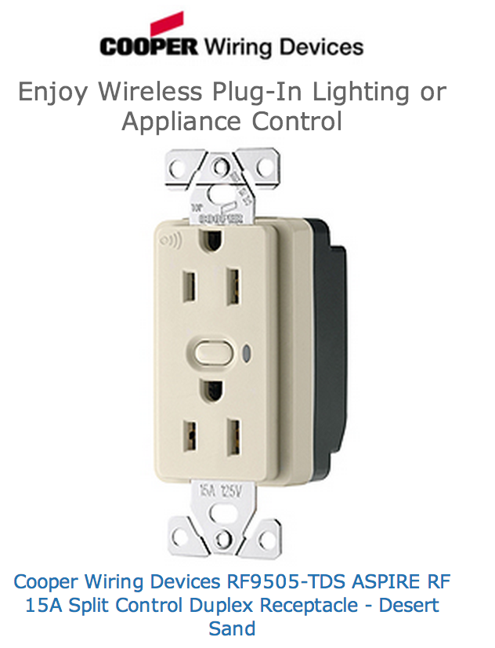
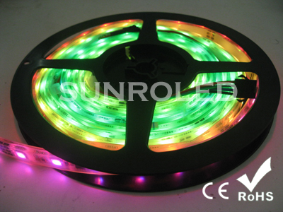
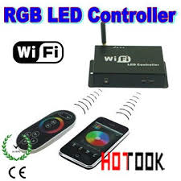
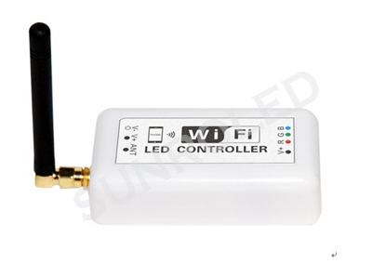
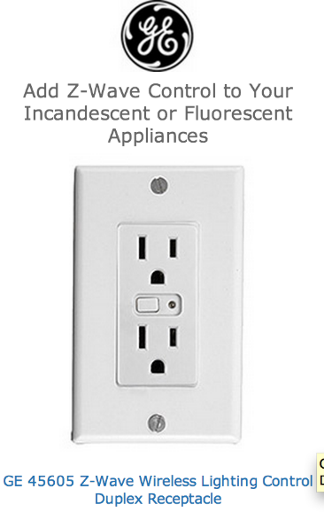
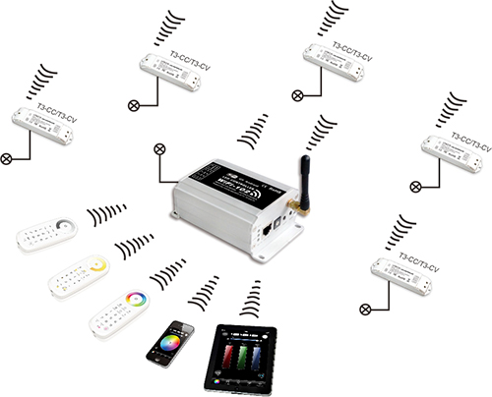
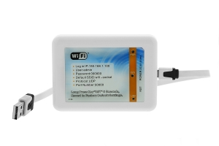
2014

Slide 9
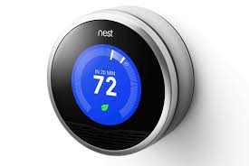
2013
The Nest makes headlines!

Slide 10
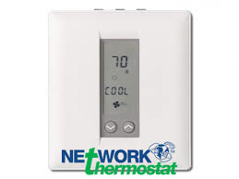
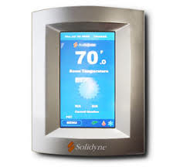
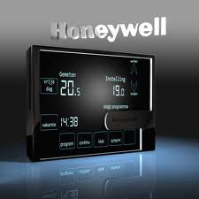
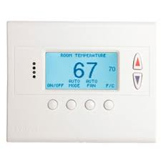
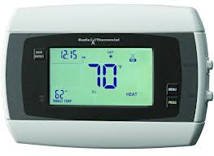
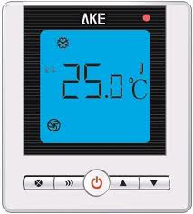
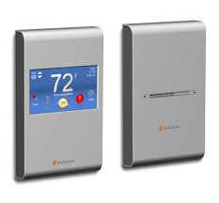
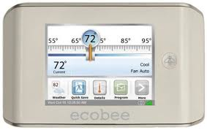
2014

Slide 11
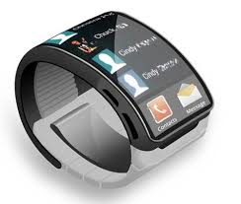
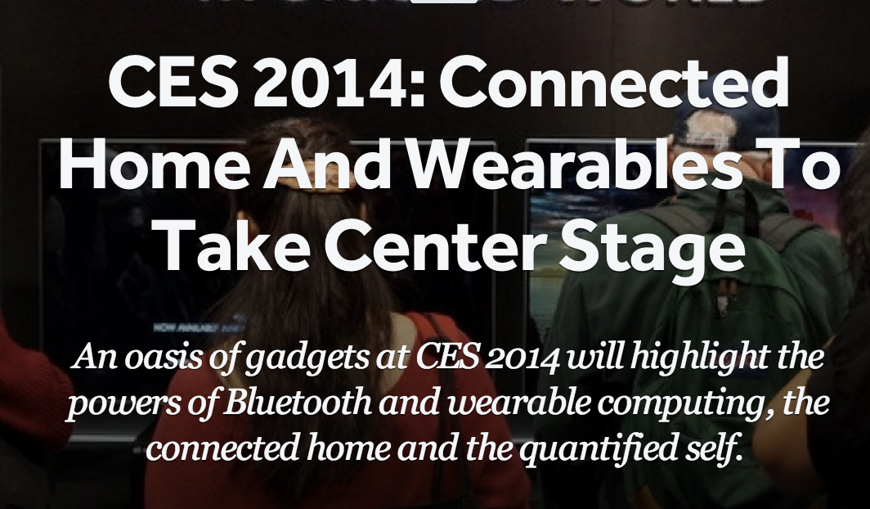
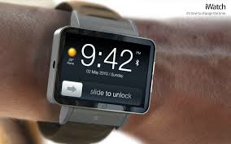
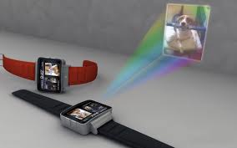
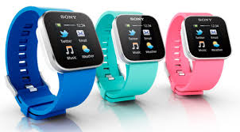
2014

Slide 12











Broad Technology Trends
Moore’s Law: # transistors on cost-effective chip doubles every 18 months
Bell’s Law: a new computer class emerges every 10 years
Computers
Per Person
1:10⁶
Mainframe
Mini
1:10³
Workstation
PC
1:1
Laptop
PDA
Cell
Today: 1 million transistors per $
10³:1
years
Mote!
Same fabrication technology provides CMOS radios for communication and micro-sensors

Slide 13




















‘Low-Tech’ Enabling Technology
Network
Microcontroller
Flash
Storage
Radio
Communication
Sensors
IEEE 802.15.4

Slide 14





The Systems Challenge
Monitoring & Managing Spaces and Things
applications
data
mgmt
service
network
system
architecture
Comm.
Store
actuate
sensing
Proc
technology
Power
Miniature, low-power connections to the physical world
Notes:
Now that we’ve set the context, here’s a picture of the rest of the presentation
I do
Kris does

Slide 15
Key WSN Research Developments
Event-Driven Component-Base Operating System
Framework for building System & Network abstractions
Low-Power Protocols
Hardware and Application Specific
Idle listening
All the energy is consumed by listening for a packet to receive
=> Turn radio on only when there is something to hear
Reliable routing on Low-Power & Lossy Links
Power, Range, Obstructions => multi-hop
Always at edge of SNR => loss is common
=> monitoring, retransmission, and local rerouting
Trickle – don’t flood (tx rate < 1/density, and < info change)
Connectivity is determined by physical points of interest, not network designer.
never naively respond to a broadcast
re-broadcast very very politely

Slide 16


Internet of Every Thing – Realized 2008
 | ROM | RAM
CC2420 Driver | 3149 | 272
802.15.4 Encryption | 1194 | 101
Media Access Control | 330 | 9
Media Management Control | 1348 | 20
6LoWPAN + IPv6 | 2550 | 0
Checksums | 134 | 0
SLAAC | 216 | 32
DHCPv6 Client | 212 | 3
DHCPv6 Proxy | 104 | 2
ICMPv6 | 522 | 0
Unicast Forwarder | 1158 | 451
Multicast Forwarder | 352 | 4
Message Buffers | 0 | 2048
Router | 2050 | 106
UDP | 450 | 6
TCP | 1674 | 50
24038 | ROM
3598 | RAM
(including runtime)
* Production implementation on TI msp430/cc2420
Footprint, power, packet size, & bandwidth
Open version 27k / 4.6k

Slide 17






Internet of Every Thing – standardized 2010

Slide 18



Smart meter rollouts
Open IPv6, …
Proprietary / Zigbee
http://www.edisonfoundation.net/iee/Documents/IEE_SmartMeterRollouts_0512.pdf

Slide 19






































The Mote/TinyOS revolution…
Mote inside
uP => Arm Cortex
Radio => 802.15.4g narrow=band freq. hopper
TinyOS too
SOC from here
zeevo BT
Intel
iMOTE
Intel
MOTE2
Intel
rene’
Intel/UCB
dot
BTNode
Intel
cf-mica
Eyes
trio
IETF RPL
SmartDust
WeC
LoWPAN/IPv6
Rene
Mica
Telos
Epic
XBOW
rene2
XBOW
mica
XBOW
cc-dot
XBOW
mica2
XBOW
micaZ
digital sun
rain-mica
Bosch
cc-mica
Dust Inc
blue cc-TI
98
99
00
0 1
02
03
04
05
06
07
10
11
SENSIT
Expedition
NEST
CENS STC
NETS/ NOSS
Cyber-Physical
8 kB rom
½ kB ram
NSF
48 kB rom
10 kB ram
802.15.4

Slide 20



TinyOS – Framework for Innovation
Applications and Services
Over-the-air
Programming
Network
Protocols
Blocks, Logs, Files
Scheduling, Management
Streaming drivers
Link
Radio Serial
Flash
MCU, Timers, Bus,…
ADC, Sensor I/F
WSN mote platform
Wireless
Storage
Processing
Sensors
Communication Centric
Resource-Constrained
Event-driven Execution

Slide 21
Back to The Internet of Everything…?

Slide 22




An More Global Application Model
Channel
Channel
Channel
Sensors
with Aggregation
Real-Time Components
Channel
Transform and Archive
Channel
SwarmLet (“The Application”)
Distributed
Archival Storage
A Swarm Application is a Connected graph of Components
Globally distributed, but locality and QoS aware
Avoid Stovepipe solutions through reusability
Many components are Shared Services written by programmers with a variety of skill-sets and motivations
Well-defined semantics and a managed software version scheme
Service Level Agreements (SLA) with micropayments
Many are “Swarmlets” written by domain programmers
They care what application does, not how it does it
Notes:
Note: We want to make it possible for everyone to construct sophisticated swarm applications by writing small components (Swarmlets)

Slide 23
SWARMLETs
SWARMLET: a software component written by domain programmer that is easy to write but exhibits sophisticated behavior by exploiting services distributed within the infrastructure
Swarmlets specify their needs in terms of human-understandable requirements
Necessary Services, Frame rates, Minimum Bandwidths
Locality, Ownership, and Micropayment parameters for sensors and/or data
Swarmlets may evolve into Shared Services
Programmers of Services used by Swarmlets think in terms of contracts provided to Swarmlets

Slide 24

Meeting the needs of the Swarm
Cloud Services
Personal/Local
Swarm
The FOG
Discover and Manage resource
Integrate sensors, portable devices, cloud components
Guarantee responsiveness, real-time behavior, throughput
Self-adapt to failure and provide performance predictability
Secure, high-performance, durable, available information
Monetize resources when necessary: micropayments

Slide 25
Support for Swarm Applications
Resource Discovery
Which resources /services are available?
What are these resources and what are their capabilities?
Who owns them and how much do I need?
Real Time Requirements
Sophisticated multimedia interactions
Control of/interaction with health-related devices
Responsiveness Requirements
Provide a good interactive experience to users
Explicitly Parallel Components
Components exploit parallelism when possible
Direct Interaction with Cloud storage and computation
Potentially extensive use of remote services
Serious security/data vulnerability concerns

Slide 26
The Missing Link?
Energy-efficient
home
Unpad
Home security/ emergency
Health monitoring
Apps
SWARM-OS
Actuators/
Output devs
Storage
Resources
Sensors/
Input devs
Networks
Computing
SWARM-OS: A mediation layer that discovers resources and connects them with applications

Slide 27
What about the “FOG” and “Cloud”? New Abstraction: the Cell
Properties of a Cell: Service Level Guarantees
A user-level software component with guaranteed resources
Has full control over resources it owns (“Bare Metal”)
Contains at least one memory protection domain (possibly more)
Contains a set of secured channel endpoints to other Cells
Contains a security context which may protect and decrypt information
When mapped to the hardware, a cell gets:
Gang-schedule hardware thread resources (“Harts”)
Guaranteed fractions of other physical resources
Physical Pages (DRAM), Cache partitions, memory bandwidth, power
Guaranteed fractions of system services
Predictability of performance ⇒
Ability to model performance vs resources
Ability for user-level schedulers to better provide QoS

Slide 28
Cell Implementation Platform: Tessellation Version 2
Tessellation Operating System
Provides basic Cell Implementation
Build on the Xen Hypervisor
Why Xen?
Provides clean starting point for resource containers
Leverage mature OS (Linux) device support, critical drivers can be isolated in a stub domain
Framework for developing VM schedulers
Mini-OS, a lightweight POSIX-compatible Xen guest OS, is basis for the customizable app runtime
Support for ARM and x86
Unikernels: Software Appliances
Small compiled kernels with only enough components to support one application
Every component has its own resource container
Dynamic resource optimization framework
Notes:
Include here detailed descriptions of the slide content for use in the presentation

Slide 29
Implementing Cells: Space-Time Partitioning
Space
Time
Space
Spatial Partition: Performance isolation
Each partition receives a vector of basic resources
A number HW threads
Chunk of physical memory
A portion of shared cache
A fraction of memory BW
Shared fractions of services
Partitioning varies over time
Fine-grained multiplexing and guarantee of resources
Resources are gang-scheduled
Controlled multiplexing, not uncontrolled virtualization
Partitioning adapted to the system’s needs

Slide 30
Resource Discovery and Ontology
Dynamically discover resources, services, and cyber-physical components (sensors/actuators) that meet application requirements
Find local components that meet some specification
Use ontology to describe exactly what component do
Distribute these resources (or fractions of services) to application cells in order to meet QoS requirements
Many partial solutions out there, no complete solutions
Must deal with locality (discover local items) while at same time dealing with remote (global) services
Must gracefully handle failover of components
One important aspect is that resources must be handed out only to authorized users
Authorization can involve ownership, micropayments, etc..

Slide 31
Brokering Service: The Hierarchy of Ownership
Discover Resources in “Domain”
Devices, Services, Other Brokers
Resources self-describing?
Allocate and Distribute Resources to Cells that need them
Solve Impedance-mismatch problem
Dynamically optimize execution
Hand out Service-Level Agreements (SLAs) to Cells
Deny admission to Cells which violate existing agreements
Complete hierarchy
World graph of applications
Parent
Broker
Sibling
Broker
Local
Broker
Child
Broker
Notes:
One way to handle the natural locality of resources is to utilize a hierarchical scheme to discover them. Brokers handle local discovery of child brokers and resources at the same level. Example, a broker on your person, one in the room, one in the building, etc. The brokerage domains naturally reflect both locality and ownership.

Slide 32
DataCentric Vision
Hardware resources are a commodity
Computation resource fails? Get another
Sensor fails? Find another
Change your location? Find new resources
All that really matters is the information
Integrity, Privacy, Availability, Durability
Hardware to prevent accidental information leakage
Permanent state handled by Universal Data Storage, Distribution, and Archiving
We need a new Internet for the Internet of Things?
Communication and Storage are really duals
Why separate them?

Slide 33











The Global Data Plane
Cloud Services
Cloud Services
Archival Storage and Optimized Streaming
Aggregate/Filter
Universal Tivo
Personal Cache
Notes:
Can we provide a better substrate on which to build Swarm Applications than raw IP? One option that we are considering is the Universal Data Plane (UDP). This substrate is a universal mechanism for transferring, queuing, streaming, and archiving of information. All sources and destinations of information are given location independent names and thus live in a giant virtual space. The level of indirection is performed by an overlay network (many of which were developed during the peer-to-peer research craze of the early 2000s). This substrate can provide facilities to the common SWARMLET programmer that are only available to big companies (i.e. Google, New York Times, etc).

Slide 34
GDP Secure Log
Subscriber
Writer: Signed Source of Packets
LOG
Server
Subscriber
LOG
Replica Server
LOG
Replica
Server
Random Reader
Random Reader
Random Reader
Locality Optimization/QoS
Flat 256-bit address space
Routes adapted as elements move
Hardware QoS exploited
Multicast trees built as needed
Durability
Replicas/Reed-Solomon coding
Single Writer/Append only
Owner Key Signs entries
LOG server rejects bad entries
Tradeoff in granularity, i.e. frequency of signatures
Multiple Readers/Subscribers
Random access/push based

Slide 35

Simple Log-based Use-case
LOG
Sensors
w/key
LOG
Data
Distillation
Service
LOG
LOG
Service
w/key
(MultiWriter,
Aggregator,
Control)
Actuator
LOG
Lightweight Logs ⇒ One Log per Device
Log Input Secured via Owner Key/Checked by consumer
Optional encryption for privacy
Timestamps to help ensure freshness

Slide 36
Build DataStores on top of GDP through Composition
Common Access APIs (CAAPIs): Support common data access methods such as:
Key/Value Store
Object Store/File System
Data Base (i.e. Google Spanner)
CAPPIs exported by services that consume the LOG
Much more convenient way to access data
The LOG is the Ground Truth for data, but data is projected into a more convenient form
To do Random File access, Indexing, SQL queries, Latest value for given Key, etc
Optional Checkpoints stored for quick restart/cloning

Slide 37
Example: DataBase CAAPI
Client
w/key
Slave CAAPI Service
w/o key
Client
w/key
DataBase Client
DataBase Client
DataBase Projection
(RAM)
CAAPI Service
w/key
LOG
DataBase Projection
(RAM)
DataBase Service
(R/W)
Read/SQL
Read/Write
LOG
Replica Service
(R/O)
Read/Write
LOG
LOG Replica
Long Distance Communication
CAAPI Service can be taken down, replicated, and restarted
Time-stamp driven transactions (Google Spanner)
Cloud-based computation (Spark)

Slide 38
Properties of the GDP (Summary)
Universal way to address every stream of information
Publish/Subscribe view of information
Large flat address space (at least 256 bits)
Mechanisms for access control, privacy, and transactions
Streams of data persisted automatically for later access
Location Independence ⇒ Above network level
Build Swarmlets once and run them anywhere
Migrate or replicate running swarmlets
Locality optimization/QoS handled by underlying system
Common Access APIs (CAAPIs) provide standard Interfaces
Key/Value Store, Data Bases, File Systems
Deep Archival Storage:
Automatic Geographically Distributed Archival Storage
One system for sensors and big data

Slide 39

The Revolution
Computers
People
Everything
1T
100B
Awareness
10B
Community
1B
Connectivity
10M
1990
2000
2010
2020

Slide 40

The Revolution
Computers
People
Everything
1T
$100
100B
Cost to Connect
$1
10B
1¢
1B
Things Connected
10M
1990
2000
2010
2020

Slide 41
Use Quantum Mechanics to Compute?
Weird but useful properties of quantum mechanics:
Quantization: Only certain values or orbits are good
Remember orbitals from chemistry???
Superposition: Schizophrenic physical elements don’t quite know whether they are one thing or another
All existing digital abstractions try to eliminate QM
Transistors/Gates designed with classical behavior
Binary abstraction: a “1” is a “1” and a “0” is a “0”
Quantum Computing: Use of Quantization and Superposition to compute.
Interesting results:
Shor’s algorithm: factors in polynomial time!
Grover’s algorithm: Finds items in unsorted database in time proportional to square-root of n.
Materials simulation: exponential classically, linear-time QM

Slide 42
Quantization: Use of “Spin”
North
Spin ½ particle:
(Proton/Electron)
Representation:
|0> or |1>
South
Particles like Protons have an intrinsic “Spin” when defined with respect to an external magnetic field
Quantum effect gives “1” and “0”:
Either spin is “UP” or “DOWN” nothing between

Slide 43

Kane Proposal II (First one didn’t quite work)
Single Spin
Control Gates
Inter-bit
Control Gates
Phosphorus
Impurity Atoms
Bits Represented by combination of proton/electron spin
Operations performed by manipulating control gates
Complex sequences of pulses perform NMR-like operations
Temperature < 1° Kelvin!

Slide 44
Now add Superposition!
The bit can be in a combination of “1” and “0”:
Written as: Ψ= C₀|0> + C₁|1>
The C’s are complex numbers!
Important Constraint: |C₀|² + |C₁|² =1
If measure bit to see what looks like,
With probability |C₀|² we will find |0> (say “UP”)
With probability |C₁|² we will find |1> (say “DOWN”)
Is this a real effect? Options:
This is just statistical – given a large number of protons, a fraction of them (|C₀|² ) are “UP” and the rest are down.
This is a real effect, and the proton is really both things until you try to look at it
Reality: second choice!
There are experiments to prove it!

Slide 45
A register can have many values!
Implications of superposition:
An n-bit register can have 2^{n} values simultaneously!
3-bit example:
Ψ= C₀₀₀|000>+ C₀₀₁|001>+ C₀₁₀|010>+ C₀₁₁|011>+ C₁₀₀|100>+ C₁₀₁|101>+ C₁₁₀|110>+ C₁₁₁|111>
Probabilities of measuring all bits are set by coefficients:
So, prob of getting |000> is |C₀₀₀|², etc.
Suppose we measure only one bit (first):
We get “0” with probability: P₀=|C₀₀₀|²+ |C₀₀₁|²+ |C₀₁₀|²+ |C₀₁₁|² Result: Ψ= (C₀₀₀|000>+ C₀₀₁|001>+ C₀₁₀|010>+ C₀₁₁|011>)
We get “1” with probability: P₁=|C₁₀₀|²+ |C₁₀₁|²+ |C₁₁₀|²+ |C₁₁₁|² Result: Ψ= (C₁₀₀|100>+ C₁₀₁|101>+ C₁₁₀|110>+ C₁₁₁|111>)
Problem: Don’t want environment to measure before ready!
Solution: Quantum Error Correction Codes!

Slide 46
Spooky action at a distance
Consider the following simple 2-bit state:
Ψ= C₀₀|00>+ C₁₁|11>
Called an “EPR” pair for “Einstein, Podolsky, Rosen”
Now, separate the two bits:
If we measure one of them, it instantaneously sets other one!
Einstein called this a “spooky action at a distance”
In particular, if we measure a |0> at one side, we get a |0> at the other (and vice versa)
Teleportation
Can “pre-transport” an EPR pair (say bits X and Y)
Later to transport bit A from one side to the other we:
Perform operation between A and X, yielding two classical bits
Send the two bits to the other side
Use the two bits to operate on Y
Poof! State of bit A appears in place of Y
Light-Years?

Slide 47
Model: Operations on coefficients + measurements
Input
Complex
State
Unitary
Transformations
Measure
Output
Classical
Answer
Basic Computing Paradigm:
Input is a register with superposition of many values
Possibly all 2n inputs equally probable!
Unitary transformations compute on coefficients
Must maintain probability property (sum of squares = 1)
Looks like doing computation on all 2n inputs simultaneously!
Output is one result attained by measurement
If do this poorly, just like probabilistic computation:
If 2n inputs equally probable, may be 2n outputs equally probable.
After measure, like picked random input to classical function!
All interesting results have some form of “fourier transform” computation being done in unitary transformation

Slide 48
Shor’s Factoring Algorithm
The Security of RSA Public-key cryptosystems depends on the difficulty of factoring a number N=pq (product of two primes)
Classical computer: sub-exponential time factoring
Quantum computer: polynomial time factoring
Shor’s Factoring Algorithm (for a quantum computer)
Choose random x : 2 ≤ x ≤ N-1.
If gcd(x,N) ≠ 1, Bingo!
Find smallest integer r : x^{r} ≡ 1 (mod N)
If r is odd, GOTO 1
If r is even, a ≡ x ^{r/2} (mod N) ⇒ (a-1)×(a+1) = kN
If a ≡ N-1(mod N) GOTO 1
ELSE gcd(a ± 1,N) is a non trivial factor of N.
Easy
Easy
Hard
Easy
Easy
Easy
Easy

Slide 49
Finding r with x^{r} ≡ 1 (mod N)
Quantum
Fourier
Transform
Finally: Perform measurement
Find out r with high probability
Get |y>|a^{w’}> where y is of form k/r and w’ is related

Slide 50
Quantum Computing Architectures
Why study quantum computing?
Interesting, says something about physics
Failure to build ⇒ quantum mechanics wrong?
Mathematical Exercise (perfectly good reason)
Hope that it will be practical someday:
Shor’s factoring, Grover’s search, Design of Materials
Quantum Co-processor included in your Laptop?
To be practical, will need to hand quantum computer design off to classical designers
Baring Adiabatic algorithms, will probably need 100s to 1000s (millions?) of working logical Qubits ⇒ 1000s to millions of physical Qubits working together
Current chips: ~1 billion transistors!
Large number of components is realm of architecture
What are optimized structures of quantum algorithms when they are mapped to a physical substrate?
Optimization not possible by hand
Abstraction of elements to design larger circuits
Lessons of last 30 years of VLSI design: USE CAD

Slide 51

Quantum Circuit Model
Quantum Circuit model – graphical representation
Time Flows from left to right
Single Wires: persistent Qubits, Double Wires: classical bits
Qubit – coherent combination of 0 and 1: ψ = α|0⟩ + β|1⟩
Universal gate set: Sufficient to form all unitary transformations
Example: Syndrome Measurement (for 3-bit code)
Measurement (meter symbol) produces classical bits
Quantum CAD
Circuit expressed as netlist
Computer manpulated circuits and implementations

Slide 52
Adding Quantum ECC
T:
Encoded
π/8 (T)
Ancilla
Correct
SX
Not Transversal!
T
Correct
X
T
Correct
Correct
Correct
n-physical Qubits per logical Qubit
H
H
Correct
Correct
Correct
Syndrome
Computation
Correct
Errors
Quantum State Fragile ⇒ encode all Qubits
Uses many resources: e.g. 3-level [[7,1,3]] code 343 physical Qubits/logical Qubit)!
Still need to handle operations (fault-tolerantly)
Some set of gates are simply “transversal:”
Perform identical gate between each physical bit of logical encoding
Others (like T gate for [[7,1,3]] code) cannot be handled transversally
Can be performed fault-tolerantly by preparing appropriate ancilla
Finally, need to perform periodical error correction
Correct after every(?): Gate, Long distance movement, Long Idle Period
Correction reducing entropy ⇒ Consumes Ancilla bits
Observation: ≥ 90% of QEC gates are used for ancilla production ≥ 70-85% of all gates are used for ancilla production
QEC
Ancilla
Correct

Slide 53
Outline
Quantum Computing
Ion Trap Quantum Computing
Quantum Computer Aided Design
Area-Delay to Correct Result (ADCR) metric
Comparison of error correction codes
Quantum Data Paths
QLA, CQLA, Qalypso
Ancilla factory and Teleportation Network Design
Error Correction Optimization (“Recorrection”)
Shor’s Factoring Circuit Layout and Design

Slide 54
MEMs-Based Ion Trap Devices
Ion Traps: One of the more promising quantum computer implementation technologies
Built on Silicon
Can bootstrap the vast infrastructure that currently exists in the microchip industry
Seems to be on a “Moore’s Law” like scaling curve
12 bits exist, 30 promised soon, …
Many researchers working on this problem
Some optimistic researchers speculate about room temperature
Properties:
Has a long-distance Wire
So-called “ballistic movement”
Seems to have relatively long decoherence times
Seems to have relatively low error rates for:
Memory, Gates, Movement

Slide 55

Quantum Computing with Ion Traps
Qubits are atomic ions (e.g. Be⁺)
State is stored in hyperfine levels
Ions suspended in channels between electrodes
Quantum gates performed by lasers (either one or two bit ops)
Only at certain trap locations
Ions move between laser sites to perform gates
Classical control
Gate (laser) ops
Movement (electrode) ops
Complex pulse sequences to cause Ions to migrate
Care must be taken to avoid disturbing state
Demonstrations in the Lab
NIST, MIT, Michigan, many others
Electrode Control
Qubit Ions
Electrodes
Gate Location
Courtesy of Chuang group, MIT
Notes:
If we are going to talk about automating design of quantum circuit layouts, we need to first talk about the underlying technology model

Slide 56
An Abstraction of Ion Traps
Basic block abstraction: Simplify Layout
Evaluation of layout through simulation
Yields Computation Time and Probability of Success
Simple Error Model: Depolarizing Errors
Errors for every Gate Operation and Unit of Waiting
Ballistic Movement Error: Two error Models
Every Hop/Turn has probability of error
Only Accelerations cause error
in/out ports
straight
3-way
4-way
turn
gate locations

Slide 57
Ion Trap Physical Layout
Input: Gate level quantum circuit
Bit lines
1-qubit gates
2-qubit gates
Output:
Layout of channels
Gate locations
Initial locations of ions
Movement/gate schedule
Control for schedule
Time
q0
q1
q2
Qubits
q3
q4
q5
q6
q0
q6
q5
q2
q1
q3
q4
Notes:
This paper focuses on the automation of physical layout of ion traps, here is a more precise definition of the problem we are solving

Slide 58
Outline
Quantum Computering
Ion Trap Quantum Computing
Quantum Computer Aided Design
Area-Delay to Correct Result (ADCR) metric
Comparison of error correction codes
Quantum Data Paths
QLA, CQLA, Qalypso
Ancilla factory and Teleportation Network Design
Error Correction Optimization (“Recorrection”)
Shor’s Factoring Circuit Layout and Design

Slide 59

Vision of Quantum Circuit Design
Schematic Capture (Graphical Entry)
QEC Insertion
Partitioning
Layout
Network Insertion
Error Analysis
…
Optimization
Classical Control
Teleportation Network
OR
Custom Layout and
Scheduling
CAD Tool Implementation
Quantum Assembly
(QASM)

Slide 60
Important Measurement Metrics
Traditional CAD Metrics:
Area
What is the total area of a circuit?
Measured in macroblocks (ultimately μm² or similar)
Latency (Latency_{single})
What is the total latency to compute circuit once
Measured in seconds (or μs)
Probability of Success (P_{success})
Not common metric for classical circuits
Account for occurrence of errors and error correction
Quantum Circuit Metric: ADCR
Area-Delay to Correct Result: Probabilistic Area-Delay metric
ADCR = Area × E(Latency) =
ADCR_{optimal}: Best ADCR over all configurations
Optimization potential: Equipotential designs
Trade Area for lower latency
Trade lower probability of success for lower latency

Slide 61


How to evaluate a circuit?
First, generate a physical instance of circuit
Encode the circuit in one or more QEC codes
Partition and layout circuit: Highly dependant of layout heuristics!
Create a physical layout and scheduling of bits
Yields area and communication cost
Then, evaluate probability of success
Technique that works well for depolarizing errors: Monte Carlo
Possible error points: Operations, Idle Bits, Communications
Vectorized Monte Carlo: n experiments with one pass
Need to perform hybrid error analysis for larger circuits
Smaller modules evaluated via vector Monte Carlo
Teleportation infrastructure evaluated via fidelity of EPR bits
Finally – Compute ADCR for particular result
Normal
Monte Carlo:
n times
Vector
Monte Carlo:
single pass

Slide 62
Quantum CAD flow
Input Circuit
QEC Insert
Circuit Synthesis
QEC Optimization
Fault-Tolerant
Circuit
(No layout)
Fault Tolerant
ReSynthesis (ADCR_{optimal})
Circuit
Partitioning
Communication
Estimation
Teleportation
Network Insertion
Mapping, Scheduling,
Classical control
Partitioned
Circuit
Functional System
ReMapping
Hybrid Fault
Analysis
Output Layout
Error Analysis
Most Vulnerable Circuits
Complete Layout
P_{success}
ADCR computation

Slide 63

Example Place and Route Heuristic: Collapsed Dataflow
Gate locations placed in dataflow order
Qubits flow left to right
Initial dataflow geometry folded and sorted
Channels routed to reflect dataflow edges
Too many gate locations, collapse dataflow
Using scheduler feedback, identify latency critical edges
Merge critical node pairs
Reroute channels
Dataflow mapping allows pipelining of computation!
q0
q0
q0
q1
q1
q1
q2
q2
q2
q3
q3
q3
Notes:
Greedy places gates with no global knowledge of the circuit structure, our second heuristic tries to exploit spatial locality in the given circuit by laying out gates in roughly dataflow order
Number of gate locations is same as circuit gates, so in the millions this doesn’t work but it is a start
Columns sorted to maximize left to right motion without turns
As mentione, qubits flow left to right naturally in this design, so this heuristic is especially well suited to circuits that operate repeatedly on streams of qubits at high throughput, inheirently pipelined

Slide 64
Outline
Quantum Computing
Ion Trap Quantum Computing
Quantum Computer Aided Design
Area-Delay to Correct Result (ADCR) metric
Comparison of error correction codes
Quantum Data Paths
QLA, CQLA, Qalypso
Ancilla factory and Teleportation Network Design
Error Correction Optimization (“Recorrection”)
Shor’s Factoring Circuit Layout and Design

Slide 65
Quantum Logic Array (QLA)
Anc
Anc
Anc
Syndrome
Correct
EPR
EPR
EPR
Comp
Comp
Comp
n-physical
Qubits
Ancilla
Factory
EPR
TP
EPR
TP
EPR
TP
Correct
Anc
Anc
Anc
Comp
EPR
Comp
EPR
Comp
EPR
Correct
EPR
EPR
TP
EPR
TP
EPR
TP
1 or 2-Qubit
Gate (logical)
Anc
Anc
Anc
Teleporter
NODE
EPR
EPR
Comp
EPR
Comp
EPR
Comp
EPR
Storage for
2 Logical Qubits
(In-Place)
Basic Unit:
Two-Qubit cell (logical)
Storage, Compute, Correction
Connect Units with Teleporters
Probably in mesh topology, but details never entirely clear from original papers
First Serious (Large-scale) Organization (2005)
Tzvetan S. Metodi, Darshan Thaker, Andrew W. Cross, Frederic T. Chong, and Isaac L. Chuang
EPR

Slide 66
Running Circuit at “Speed of Data”
Often, Ancilla qubits are independent of data
Preparation may be pulled offline
Very clear Area/Delay tradeoff:
Ancilla qubits should be ready “just in time” to avoid ancilla decoherence from idleness
Hardware Devoted to
Parallel Ancilla Generation
Q0
H
QEC
Ancilla
QEC
C
X
QEC
Ancilla
QEC
T-Ancilla
T
QEC
Ancilla
QEC
Q1
T-Ancilla
T
QEC Ancilla
QEC
QEC
Ancilla
QEC
H
QEC
Ancilla
QEC
Serial Circuit Latency
Parallel Circuit Latency

Slide 67
How much Ancilla Bandwidth Needed?
32-bit Quantum Carry-Lookahead Adder
Ancilla use very uneven (zero and T ancilla)
Performance is flat at high end of ancilla generation bandwidth
Can back off 10% in maximum performance an save orders of magnitude in ancilla generation area
Many bits idle at any one time
Need only enough ancilla to maintain state for these bits
Many not need to frequently correct idle errors
Conclusion: makes sense to compute ancilla requirements and share area devoted to ancilla generation

Slide 68
Ancilla Factory Design I
“In-place” ancilla preparation
0 Prep
Verify
?
Bit
Correct
Cat Prep
0 Prep
Verify
?
Phase
Correct
Cat Prep
0 Prep
Verify
?
Cat Prep
Encoded Ancilla
Verification Qubits
Ancilla factory consists of many of these
Encoded ancilla prepared
in many places, then
moved to output port
Movement is costly!
In-place
Prep
In-place
Prep
In-place
Prep
In-place
Prep

Slide 69
Ancilla Factory Design II
Pipelined ancilla preparation: break into stages
Steady stream of encoded ancillae at output port
Fully laid out and scheduled to get area and bandwidth estimates
Physical
0 Prep
CNOTs
Verif
X/Z
Correct
Cat Prep
Junk Physical Qubits
Crossbar
Crossbar
Crossbar
Good Encoded Ancillae
CNOTs
Physical
0 Prep
X/Z
Correct
Cat Prep
Verif
Recycle cat state qubits and failures
Recycle used correction qubits

Slide 70
The Qalypso Datapath Architecture
Dense data region
Data qubits only
Local communication
Shared Ancilla Factories
Distributed to data as needed
Fully multiplexed to all data
Output ports ( ): close to data
Input ports ( ): may be far from data (recycled state irrelevant)
Regions connected by teleportation networks
R
R
R

Slide 71
Tiled Quantum Datapaths
Anc
Anc
Anc
Anc
Anc
Anc
Anc
Anc
EPR
EPR
Mem
EPR
Mem
EPR
Mem
Mem
EPR
Mem
Comp
Comp
Comp
EPR
TP
EPR
TP
EPR
EPR
TP
EPR
TP
EPR
EPR
TP
EPR
TP
EPR
Anc
Anc
Anc
Anc
Anc
Anc
Anc
Anc
Anc
EPR
EPR
EPR
EPR
Comp
EPR
Comp
Comp
Comp
Comp
Comp
Comp
Comp
EPR
TP
EPR
TP
EPR
EPR
TP
EPR
TP
EPR
EPR
TP
EPR
Anc
Anc
Anc
Anc
Anc
Anc
Anc
Anc
EPR
EPR
Mem
EPR
Mem
EPR
Mem
Mem
EPR
Comp
Comp
Comp
Comp
Previous: QLA, LQLA
Previous: CQLA, CQLA+
Our Group: Qalypso
Several Different Datapaths mappable by our CAD flow
Variations include hand-tuned Ancilla generators/factories
Memory: storage for state that doesn’t move much
Less/different requirements for Ancilla
Original CQLA paper used different QEC encoding
Automatic mapping must:
Partition circuit among compute and memory regions
Allocate Ancilla resources to match demand (at knee of curve)
Configure and insert teleportation network

Slide 72
Which Datapath is Best?
Random Circuit Generation
f(Gate Count, Gate Types, Qubit Count, Splitting factor)
Splitting factor (r): measures connectivity of the circuit
Example: 0.5 splits Qubits in half, adds random gates between two halves, then recursively splits results
Closely related to Rent’s parameter
Qalypso clear winner (for all r)
4x lower latency than LQLA
2x smaller area than CQLA+
Why Qalypso does well:
Shared, matched ancilla generation
Automatic network sizing (not one Teleporter for every two Qubits)
Automatic Identification of Idle Qubits (memory)
LQLA and CQLA+ perform close second
Original datapaths supplemented with better ancilla generators, automatic network sizing, and Idle Qubit identification
Original QLA and CQLA do very poorly for large circuits

Slide 73
How to design Teleportation Network
Incoming Classical Information
(Unique ID, Dest, Correction Info)
CC
Storage
CC
Y Teleporters
CC
EPR Stream
Storage
X Teleporters
Storage
Outgoing Message
Storage
CC
What is the architecture of the network?
Including Topology, Router design, EPR Generators, etc..
What are the details of EPR distribution?
What are the practical aspects of routing?
When do we set up a channel?
What path does the channel take?

Slide 74
Basic Idea: Chained Teleportation
Teleportation
Teleportation
T
G
T
G
T
G
T
G
T
G
T
P
Adjacent T nodes linked for teleportation
P
Positive Features
Regularity (can build classical network topologies)
T node linking not on critical path
Pre-purification part of link setup
Fidelity amplification of the line
Allows continuous stream of EPR correlations to be established for use when necessary

Slide 75
Pre-Purification
T
Long-Distance EPR Pairs Per Data Communication
G
T
Error Rate Per Operation
Experiment: Transmit enough EPR pairs over network to meet required fidelity of channel
Measure total global traffic
Higher Fidelity local EPR pairs ⇒ less global EPR traffic
Benefit: decreased congestion at T Nodes

Slide 76
Building a Mesh Interconnect
T
G
T
G
T
G
T
P
P
P
P
G
G
G
G
Gate
Gate
Gate
Gate
T
G
T
G
T
G
T
P
P
P
P
Gate
Gate
Gate
Gate
Grid of T nodes
, linked by G nodes
Packet-switched network
- Options: Dimension-Order or Adaptive Routing
- Precomputed or on-demand start time for setup
Each EPR qubit has associated classical message

Slide 77
Outline
Quantum Computing
Ion Trap Quantum Computing
Quantum Computer Aided Design
Area-Delay to Correct Result (ADCR) metric
Comparison of error correction codes
Quantum Data Paths
QLA, CQLA, Qalypso
Ancilla factory and Teleportation Network Design
Error Correction Optimization (“Recorrection”)
Shor’s Factoring Circuit Layout and Design

Slide 78
Reducing QEC Overhead
Correct
Correct
Correct
Correct
Correct
Correct
H
Correct
H
H
H
Correct
Standard idea: correct after every gate, and long communication, and long idle time
This is the easiest for people to analyze
This technique is suboptimal (at least in some domains)
Not every bit has same noise level!
Different idea: identify critical Qubits
Try to identify paths that feed into noisiest output bits
Place correction along these paths to reduce maximum noise

Slide 79
Simple Error Propagation Model
Error Distance (EDist) Labels
1
Maximum EDist
propagation:
4=max(3,1)+1
1
2
1
2
Correct
3
1
4
H
2
1
Correct
3
3
1
1
4
2
EDist model of error propagation:
Inputs start with EDist = 0
Each gate propagates max input EDist to outputs
Gates add 1 unit of EDist, Correction resets EDist to 1
Maximum EDist corresponds to Critical Path
Back track critical paths that add to Maximum EDist
Add correction to keep EDist below critical threshold

Slide 80
QEC Optimization
EDist_{MAX}
iteration
QEC Optimization
EDist_{MAX}
Partitioning
and
Layout
Fault
Analysis
Input
Circuit
Optimized
Layout
Modified version of retiming algorithm: called “recorrection:”
Find minimal placement of correction operations that meets specified MAX(EDist) ≤ EDist_{MAX}
Probably of success not always reduced for EDist_{MAX} > 1
But, operation count and area drastically reduced
Use Actual Layouts and Fault Analysis
Optimization pre-layout, evaluated post-layout
1024-bit QRCA and QCLA adders

Slide 81
Recorrection in presence of different QEC codes
Probability of Success
Probability of Success
Move Error Rate per Macroblock
EDist_{MAX}=3
Idle Error Rate per CNOT Time
EDist_{MAX}=3
500 Gate Random Circuit (r=0.5)
Not all codes do equally well with Recorrection
Both [[23,1,7]] and [[7,1,3]] reasonable candidates
[[25,1,5]] doesn’t seem to do as well
Cost of communication and Idle errors is clear here!
However – real optimization situation would vary EDist to find optimal point

Slide 82
Outline
Quantum Computing
Ion Trap Quantum Computing
Quantum Computer Aided Design
Area-Delay to Correct Result (ADCR) metric
Comparison of error correction codes
Quantum Data Paths
QLA, CQLA, Qalypso
Ancilla factory and Teleportation Network Design
Error Correction Optimization (“Recorrection”)
Shor’s Factoring Circuit Layout and Design

Slide 83
Comparison of 1024-bit adders
ADCR_{optimal} for 1024-bit QRCA and QCLA
ADCR_{optimal} for 1024-bit QCLA
1024-bit Quantum Adder Architectures
Ripple-Carry (QRCA)
Carry-Lookahead (QCLA)
Carry-Lookahead is better in all architectures
QEC Optimization improves ADCR by order of magnitude in some circuit configurations

Slide 84
Area Breakdown for Adders
Error Correction is not predominant use of area
Only 20-40% of area devoted to QEC ancilla
For Optimized Qalypso QCLA, 70% of operations for QEC ancilla generation, but only about 20% of area
T-Ancilla generation is major component
Often overlooked
Networking is significant portion of area when allowed to optimize for ADCR (30%)
CQLA and QLA variants didn’t really allow for much flexibility

Slide 85

Investigating 1024-bit Shor’s
Full Layout of all Elements
Use of 1024-bit Quantum Adders
Optimized error correction
Ancilla optimization and Custom Network Layout
Statistics:
Unoptimized version: 1.35×10¹⁵ operations
Optimized Version 1000X smaller
QFT is only 1% of total execution time

Slide 86

1024-bit Shor’s Continued
Circuits too big to compute P_{success}
Working on this problem
Fastest Circuit: 6×10⁸ seconds ~ 19 years
Speedup by classically computing recursive squares?
Smallest Circuit: 7659 mm²
Compare to previous estimate of 0.9 m² = 9×10⁵ mm²

